Slide 1
SE108 Support information
1/20/15

Slide 2
SE108 Enclosure specs
Depth rating:70 m (100 psi)
Dimensions:
Weight: ~20 kg (~45 lbs)?
Length: 0.7 m (27.5”)?
Diameter: 24 cm (8.5”)
Materials:
Housing: White PVC sch. 80
Endcaps: Black Delrin
Subconn circular micro connectors (brass, neoprene)

Slide 3
SE108 hardware specs
Electrical (See CR1000 manual for datalogger specifics):
Voltage range
Input: 9-16 VDC
Output: 11-16 VDC, unregulated
Power consumption
Sampling: depends on sensor load and configuration (sleep + 30mA / sensor)?
Sleep:20mA?
Current limits
Input:10A (ATM fast acting) - Power in
One power input port – Teledyne impulse VSG-2-BCL
Output: unregulated voltage at 1-5A depending on port (*user selectable/field serviceable)
Seven sensor ports
Sensor port layout and configuration
1 host/PC RS232 port – Port 1
7 sensor ports
EXO (DCP-SOA sdi-12)- Port 2
Analog (1 SE channel, 0-5VDC)- Port 6
Three serial (2x sc105, 1x control ports 3 and 4)- Ports 3,5,8
One sdi12 port - Port 7
One ZT wiper* (90 degrees unless otherwise specified)-Port 4
*Power fused and switched to all sensor ports by SDM-CS8s and SSR

Slide 4
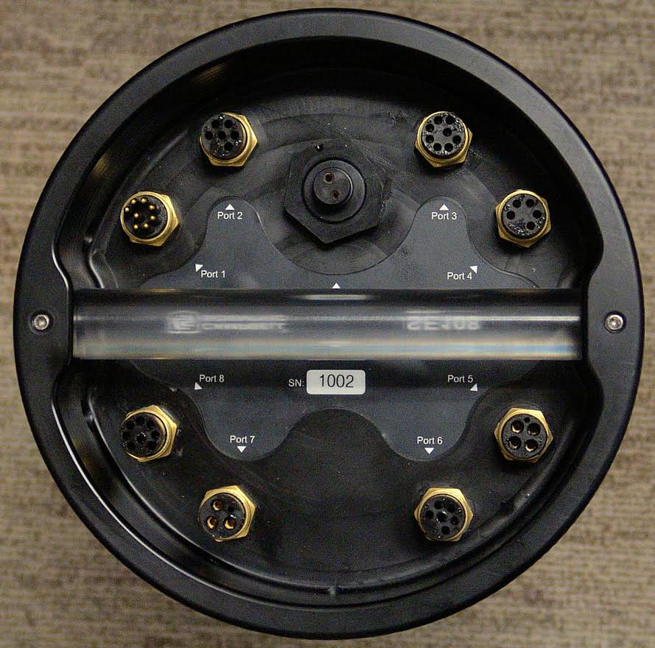
SE108 bulkhead port assignments
EXO DCP-SOA
Main Power port
Serial host
COM3 serial port
ZT Wiper port
Carrying handle
SC105 serial port (SDC7)
SC105 serial port (SDC8)
Analog port
SDI12 port

Slide 5
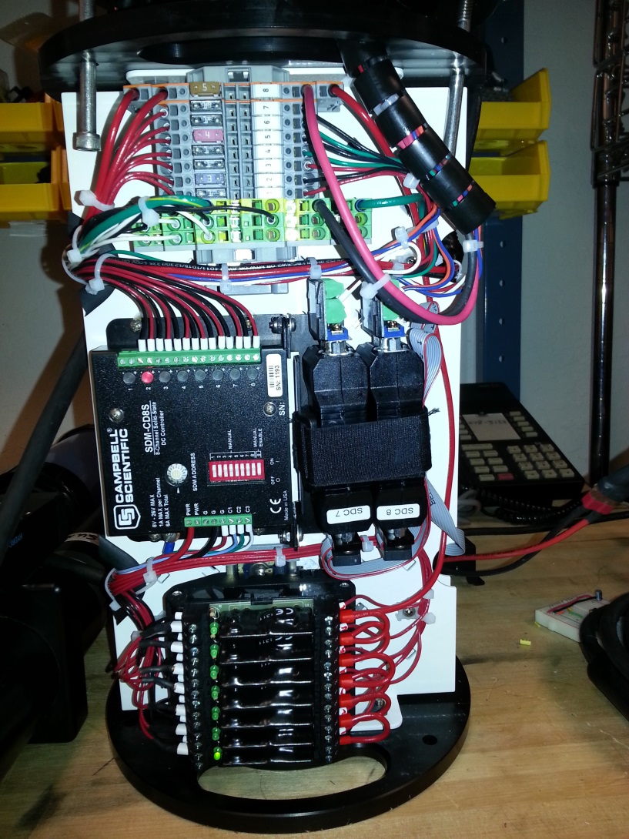
SE108 internals (power side)
Fuse array
Main power input
SC105 serial interface (2x)
SDM relay board
Solid state relay array

Slide 6
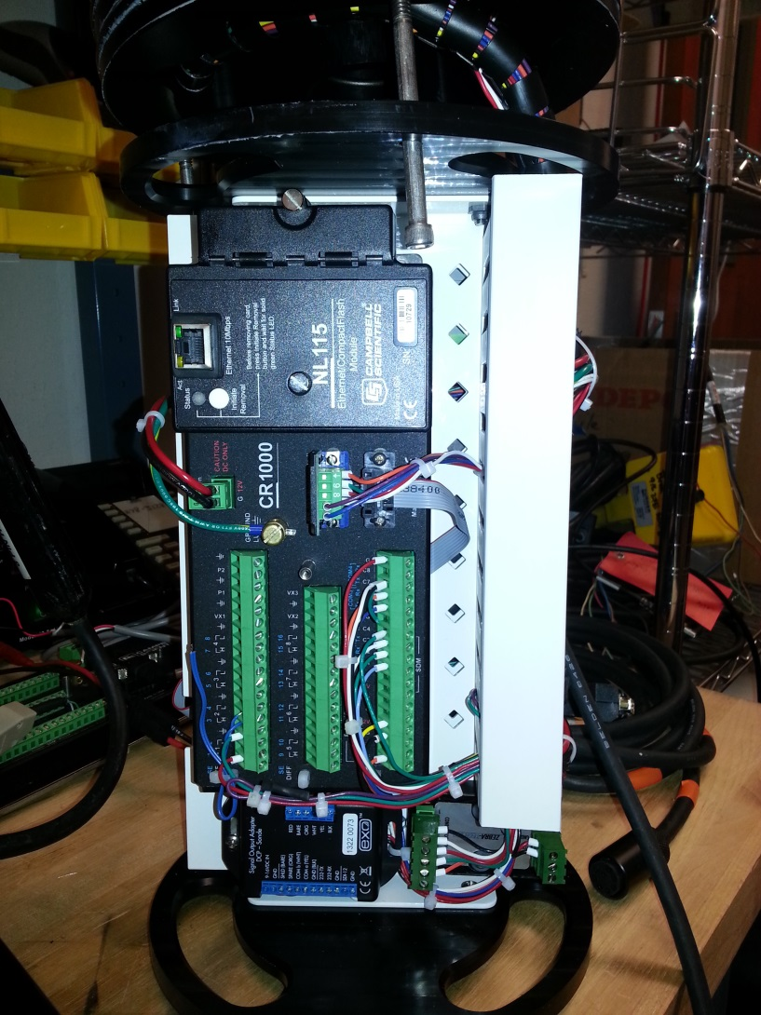
SE108 internals (control side)
NL115
CF card slot
CR1000
Wiper driver board
DCP-SOA

Slide 7
Wiring diagram

